Slide 1
NCI update – analyzing CyTOF data
12-6-2024
Ty Bottorff – Bioinformatics postdoc
Linsley lab

Slide 2
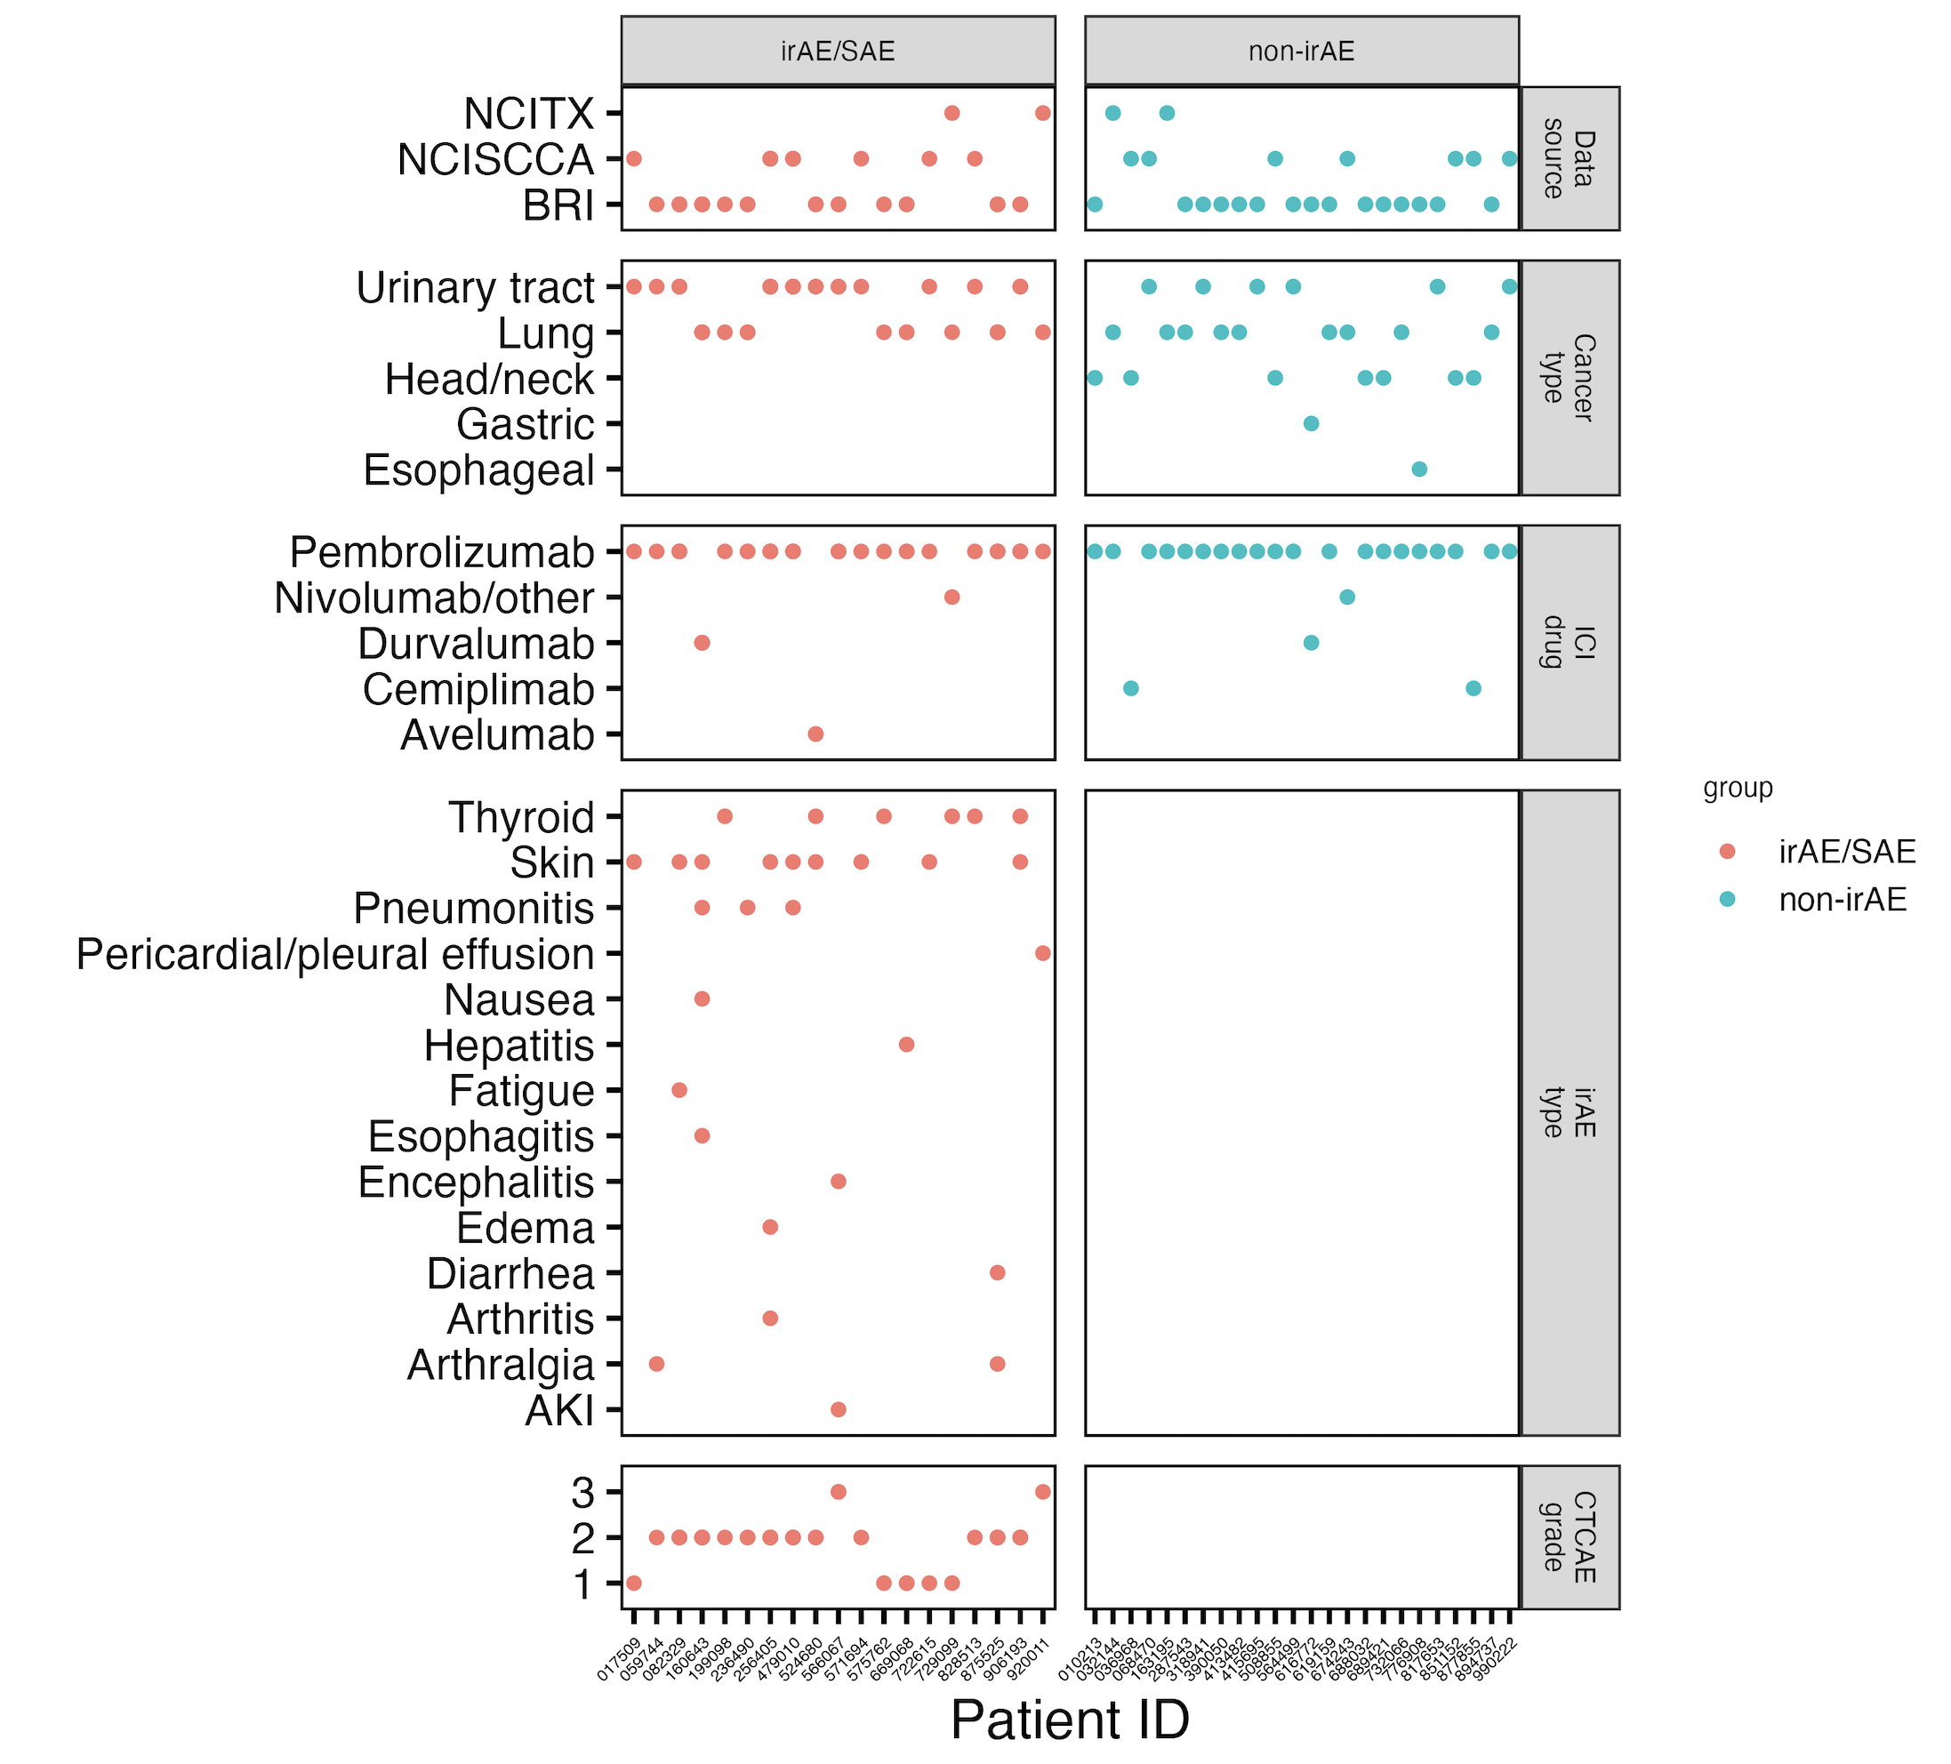
Cancer cohort metadata
Notes:
Ask Jane if grouping arthralgia and arthritis ok here for rheumatoid group (n = 3)

Slide 3
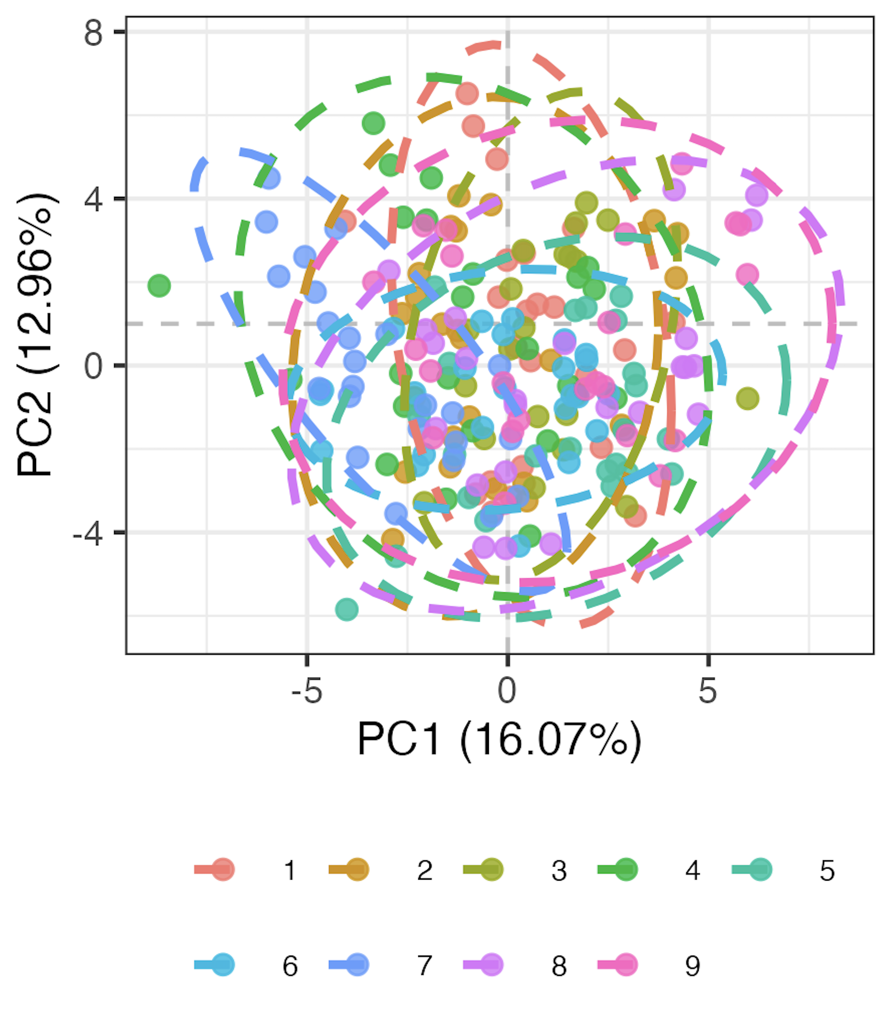
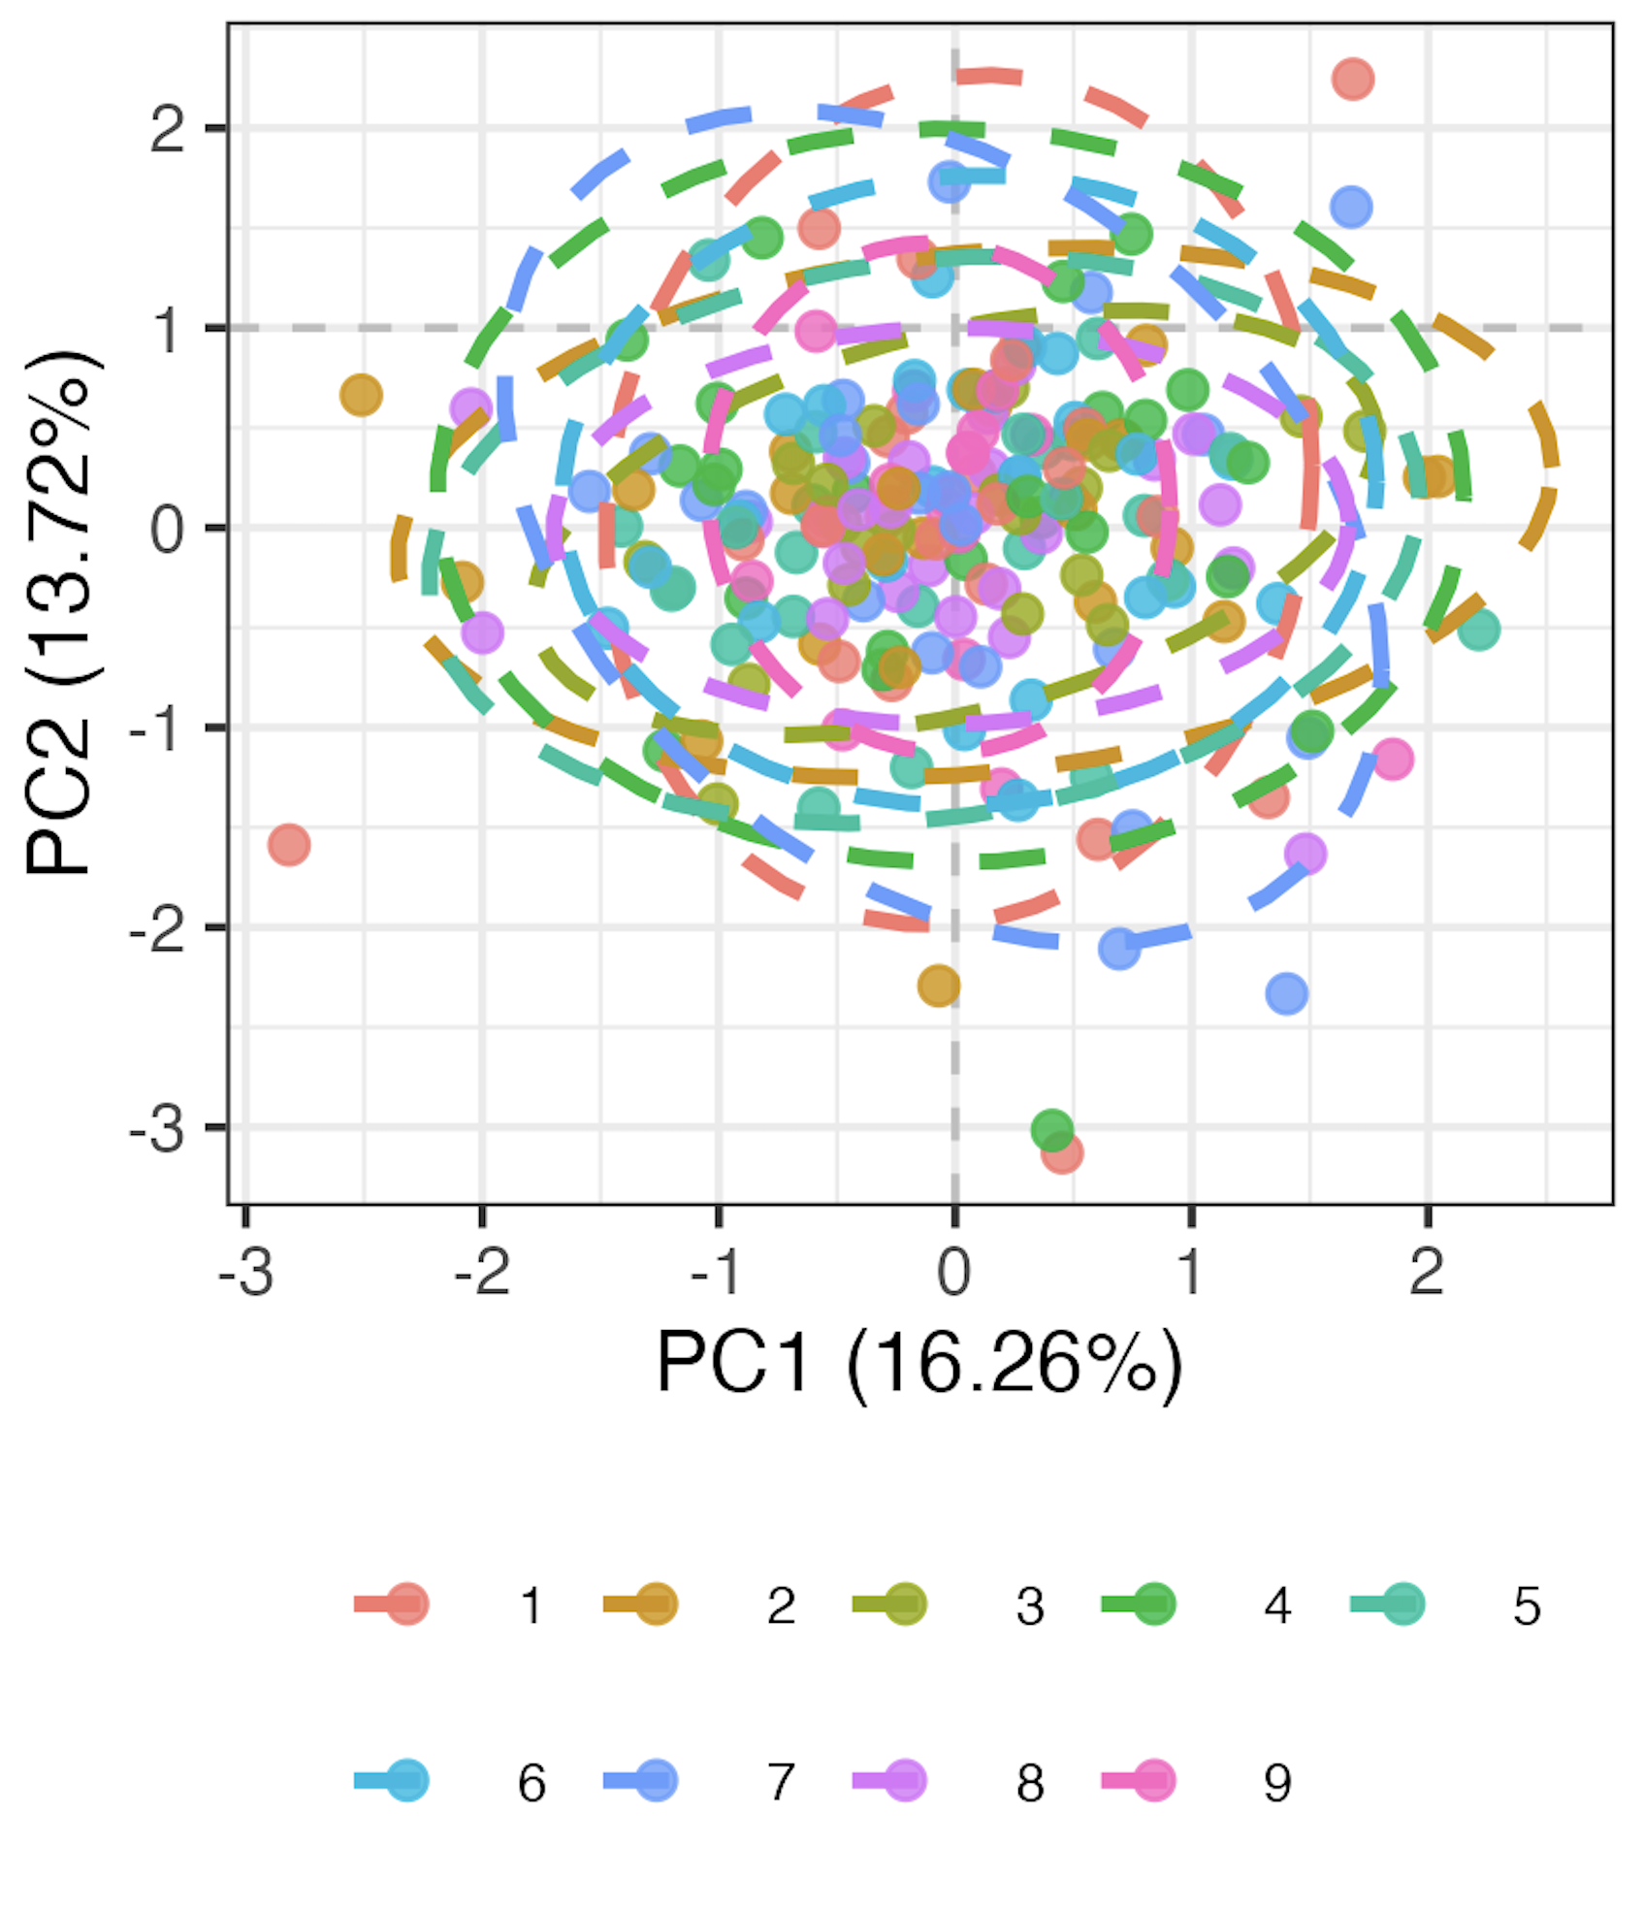
Methods overview
Remove 9 features with high technical variation
Normalize percent of parent data
Logit transform, Z-scale
Run mixed-effects LM for each of 71 remaining features, take residuals as batch-corrected data (model <- lmer(freq ~ batch + (1|patient_id)))
For PCA, remove 6 features with > 5% NAs, otherwise replace NAs with feature means
Pre
Post
Batch
Batch
Notes:
Logit transforms 0-1 to –inf, inf to normalize data
This is likely overcorrecting but no better idea (yet)

Slide 4
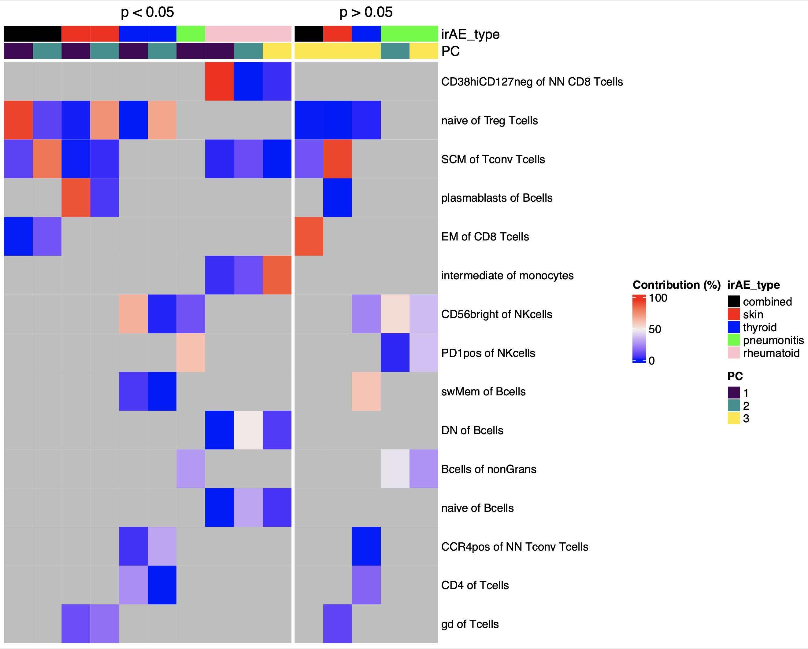
Some features appear more irAE type-specific at baseline
reported enriched in ICI-arthritis joints (Wang et al. Sci Immunol., 2023)
reported lower in severe irAE patients at irAE time (Kovacsovics-Bankowski et al. J Immunother Cancer. 2024)
Notes:
Whittled down feature lists for each irAE type comparison to still get some PC comparison pval < 0.05 while not whittling down TOO far, these are the same cutoffs/feature lists for next few slides (except for pneumonitis, just took top 3 to be able to make PCs 1-3)

Slide 5
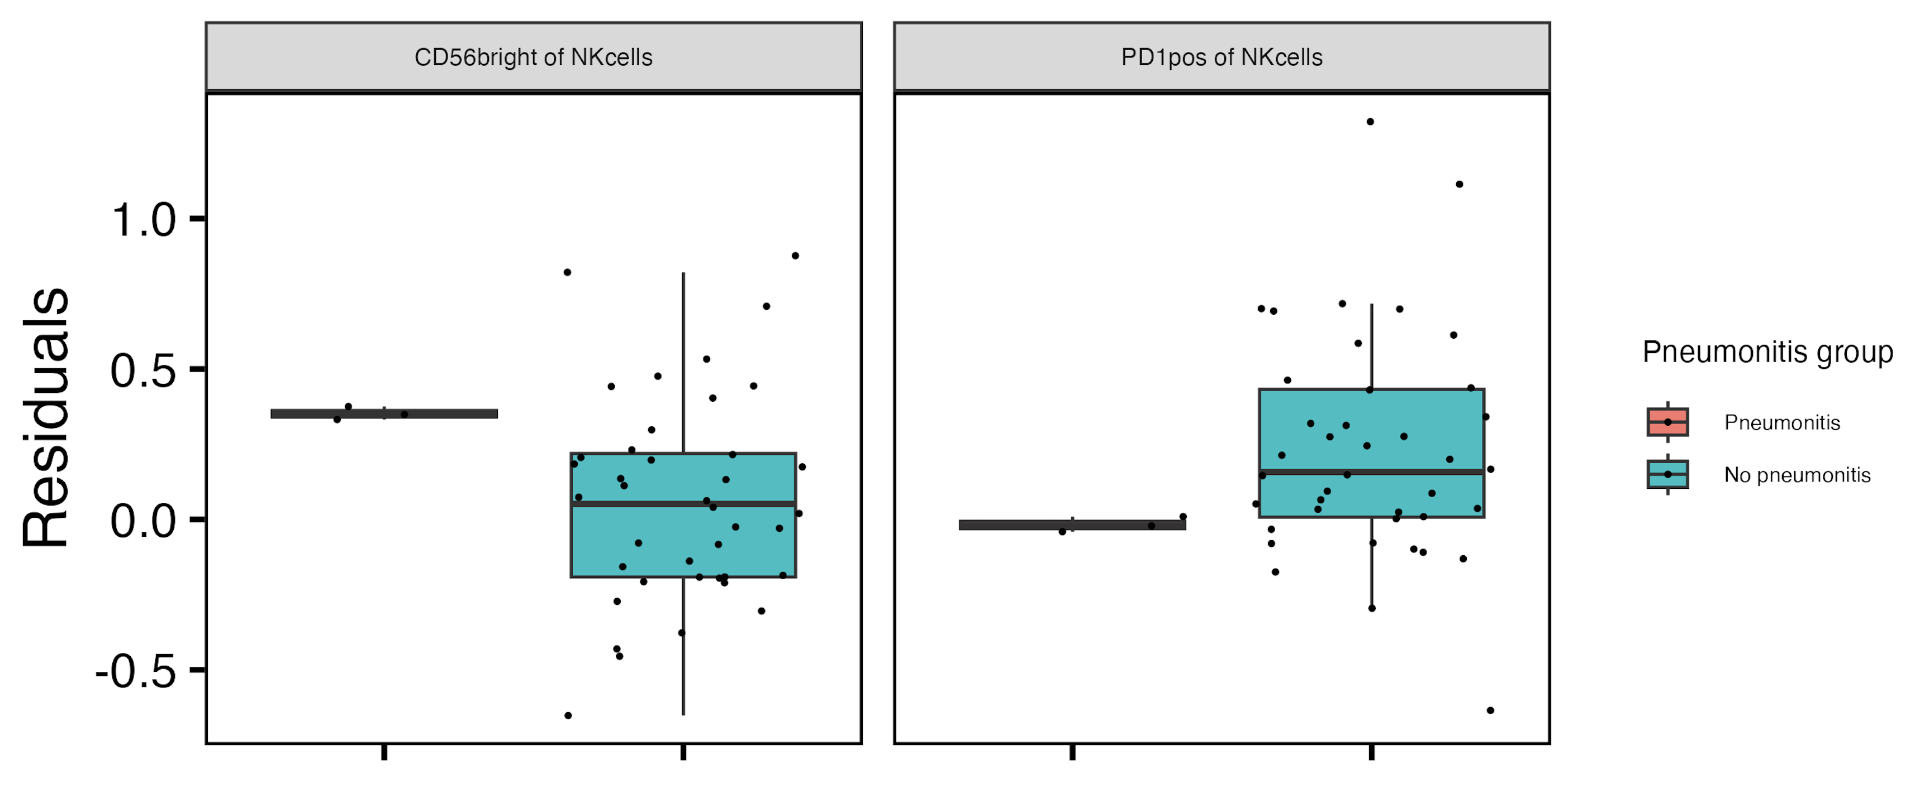
Baseline CD56^{bright} of NK cells frequency higher, PD1⁺ of NK cells frequency lower in those developing pneumonitis
**
**
Notes:
if including pleural effusion, then PD1+ of NKs drops (padj > 0.05) but it doesn’t matter for CD56bright of NKs

Slide 6
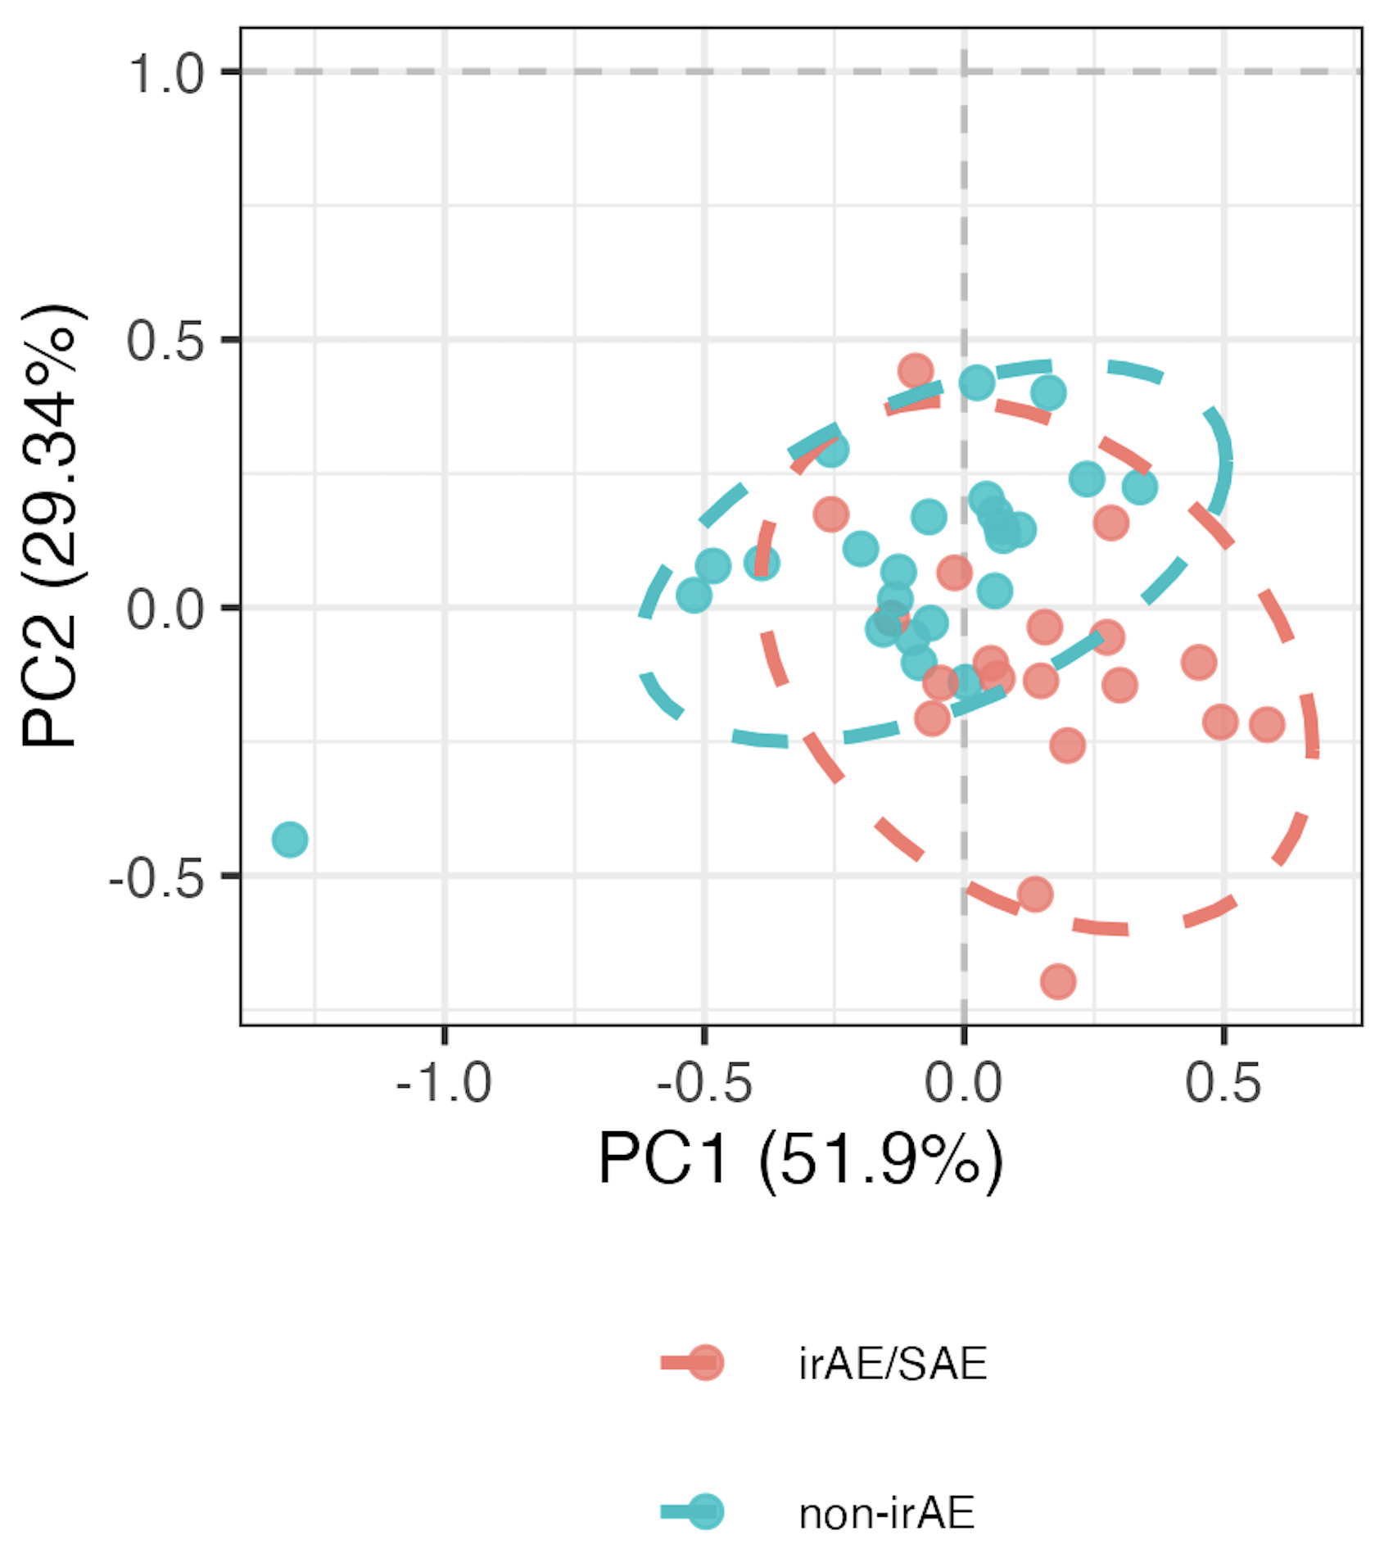
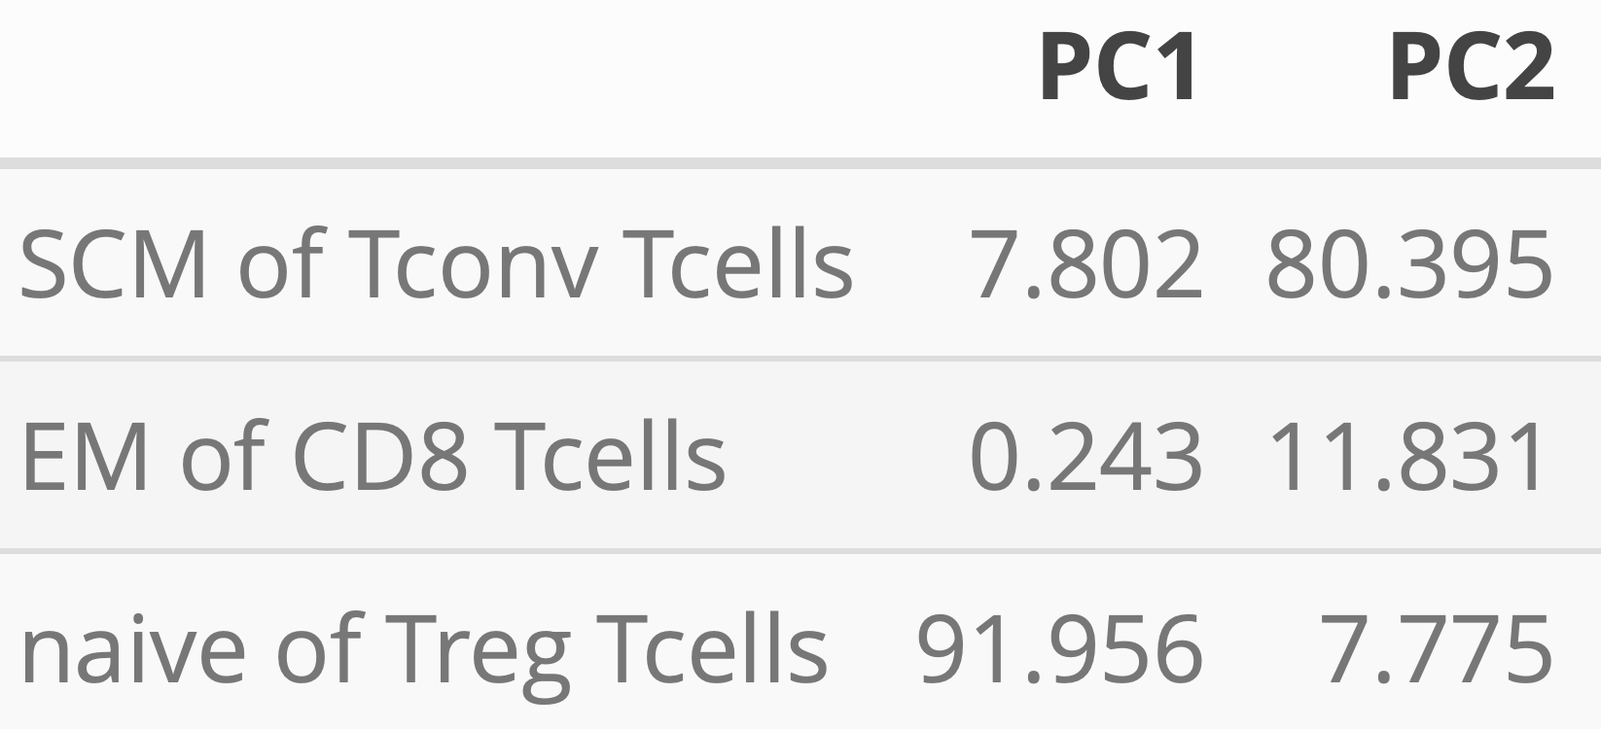
Using module of 3 baseline feature frequencies, can distinguish those who develop irAEs
PC1-2 contributions
PC1 **
PC2 **
Notes:
Module approach: whittle down # of features (arranging by pval from group comparison) while still retaining > 1 PC with pval < 0.05, ordering kind of arbitrary as padj have ties, so tried not to whittle down TOO much
Should also emphasize that modules are somewhat arbitrary in sense that multiple different configurations of mostly same features would likely work for each module approach taken here

Slide 7
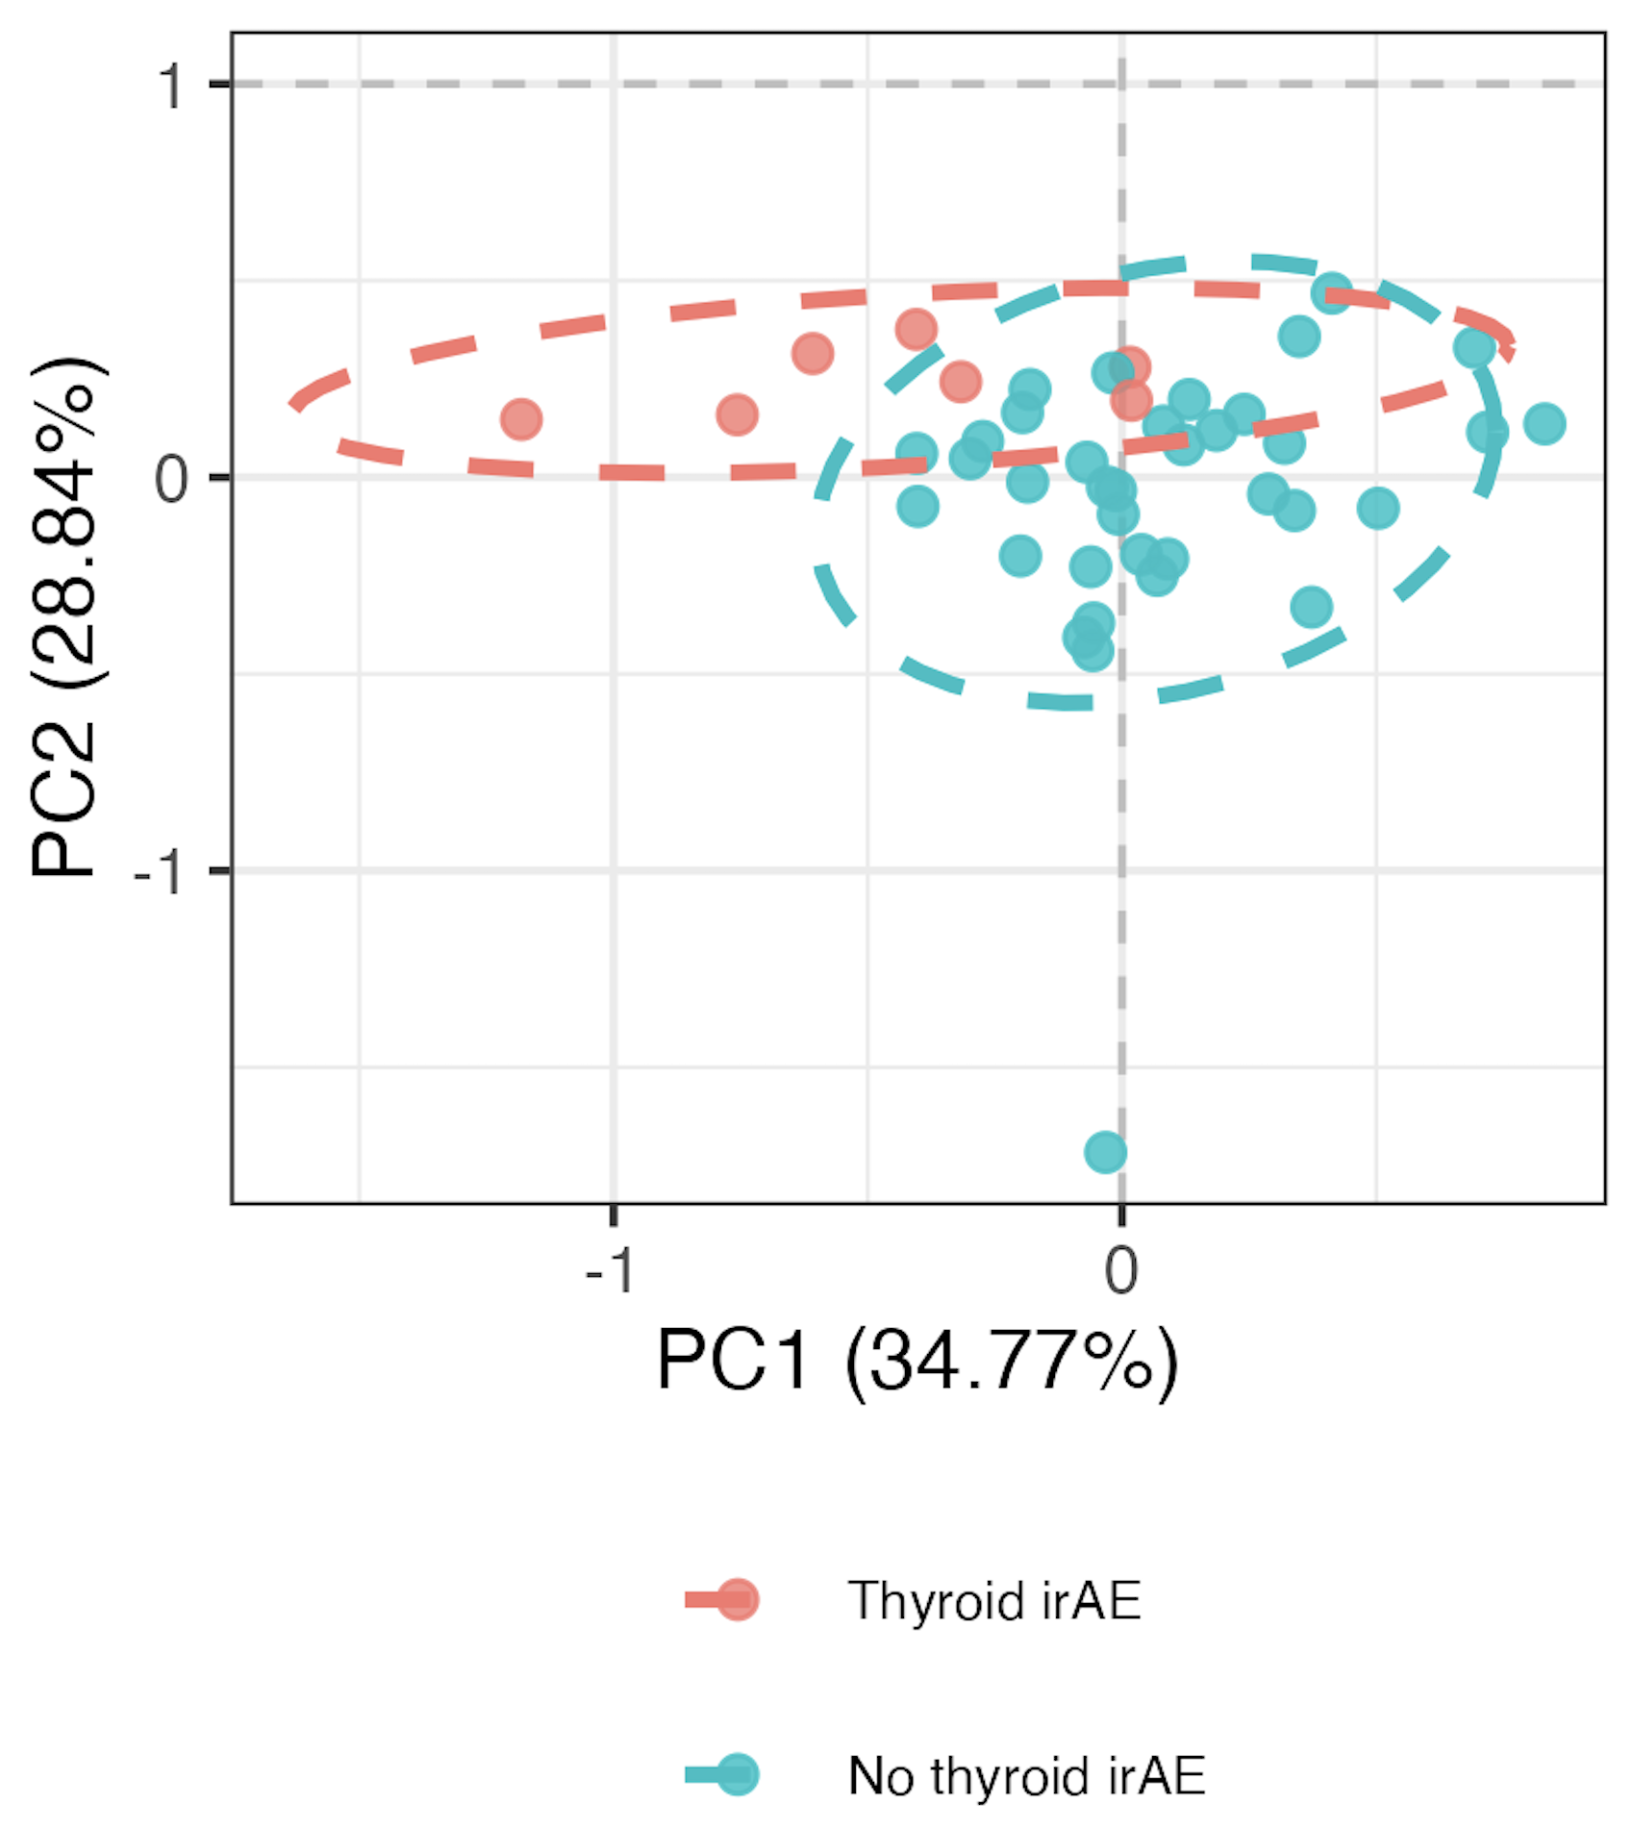
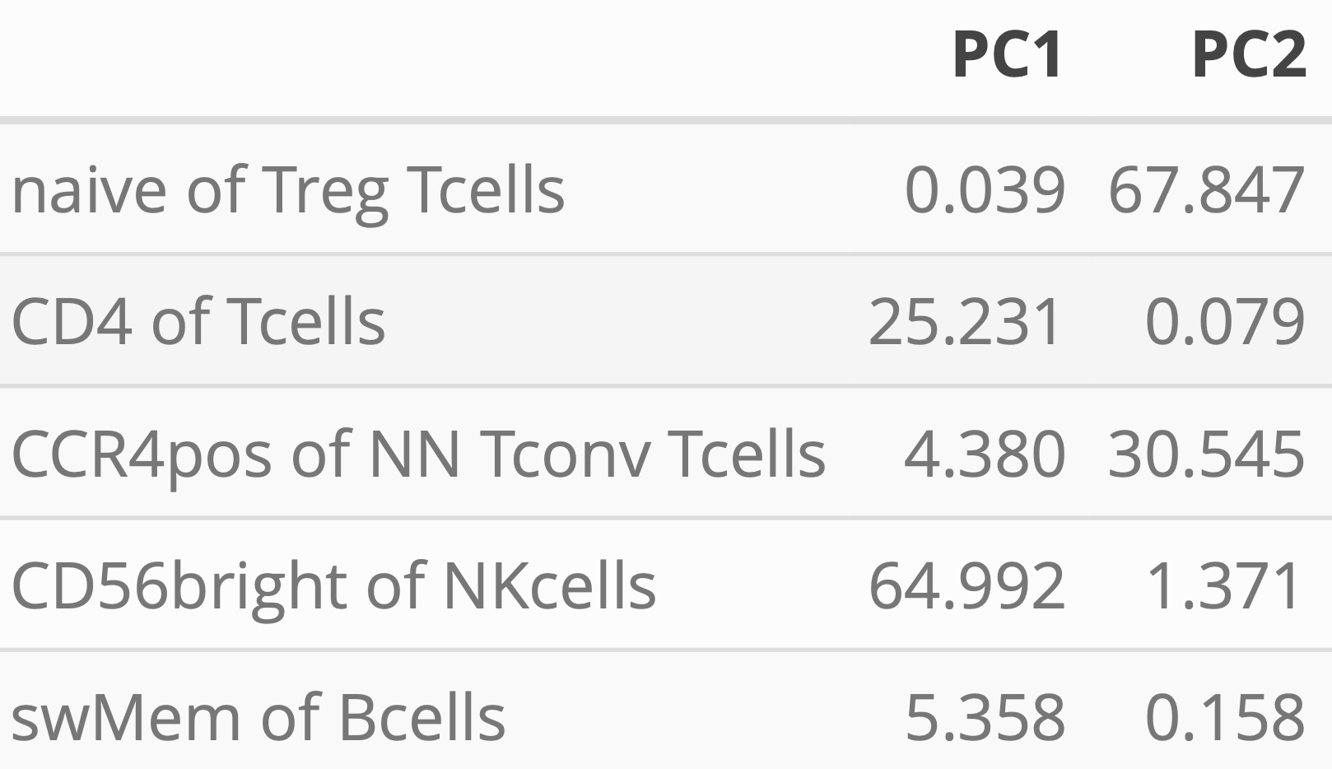
Using module of 5 baseline feature frequencies, can distinguish those who develop thyroid irAEs
PC1-2 contributions
PC1 **
PC2 **
Notes:
~similar if including OOR in sense that module needed, contributing features are mostly different (CD4 of T cells present both ways)

Slide 8
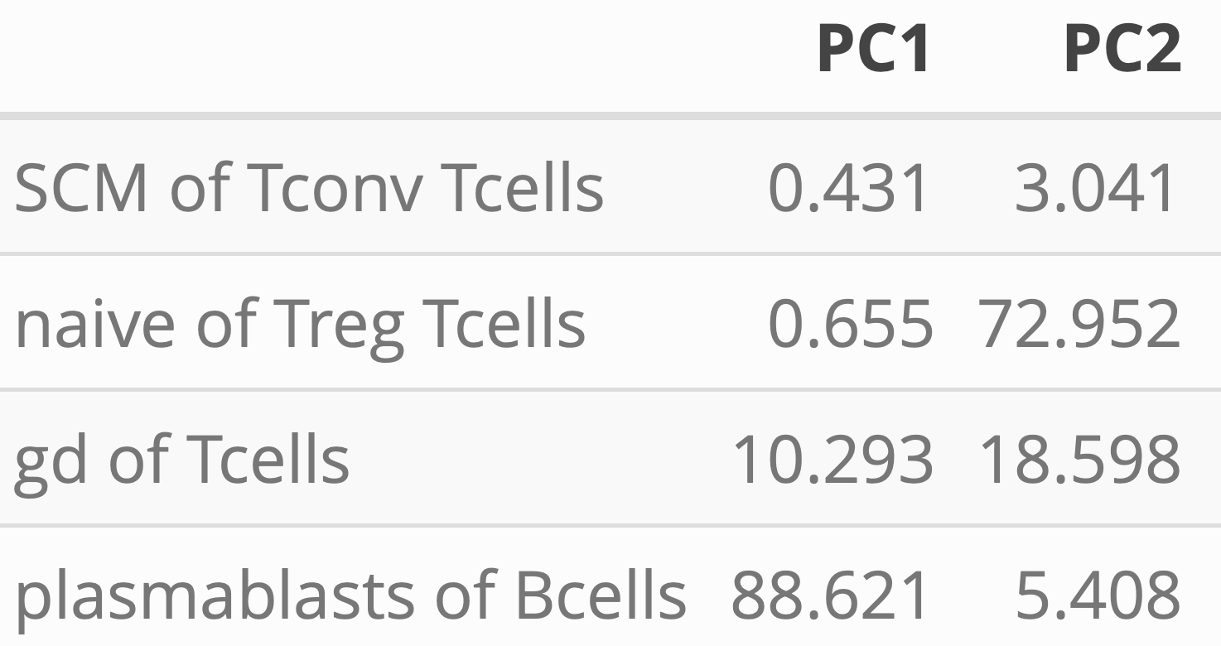
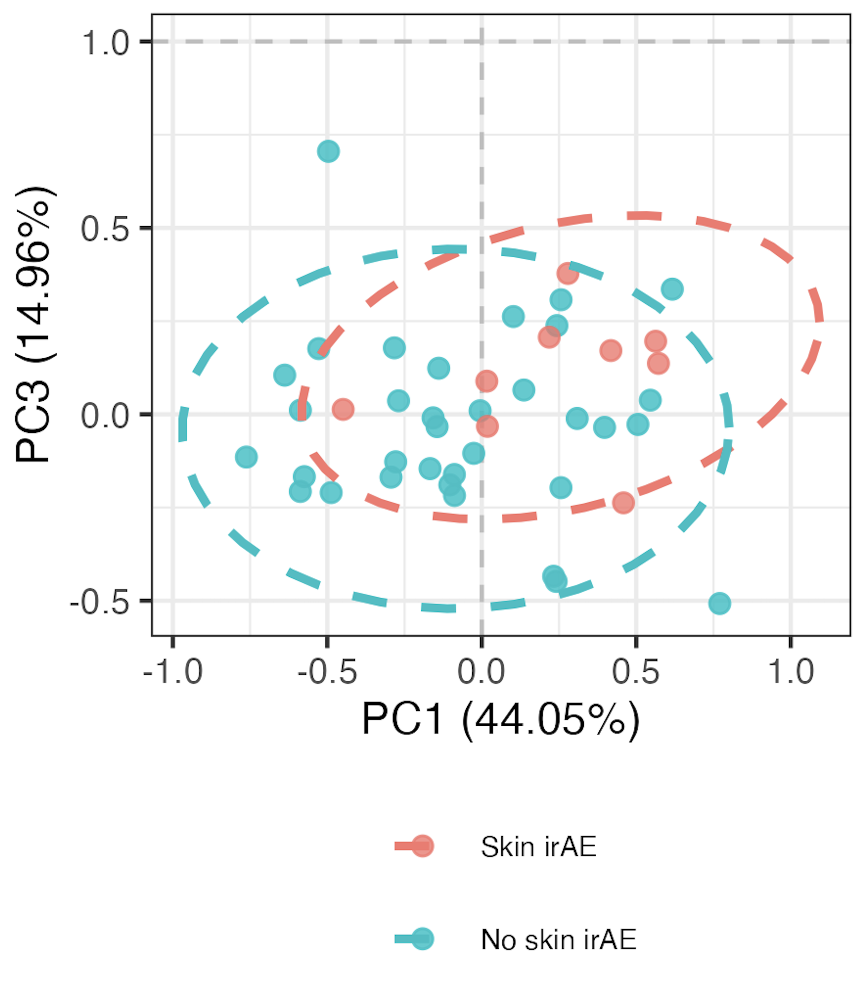
Using module of 4 baseline feature frequencies, can distinguish those who develop skin irAEs
PC1-2 contributions
PC1 *
PC2 *

Slide 9
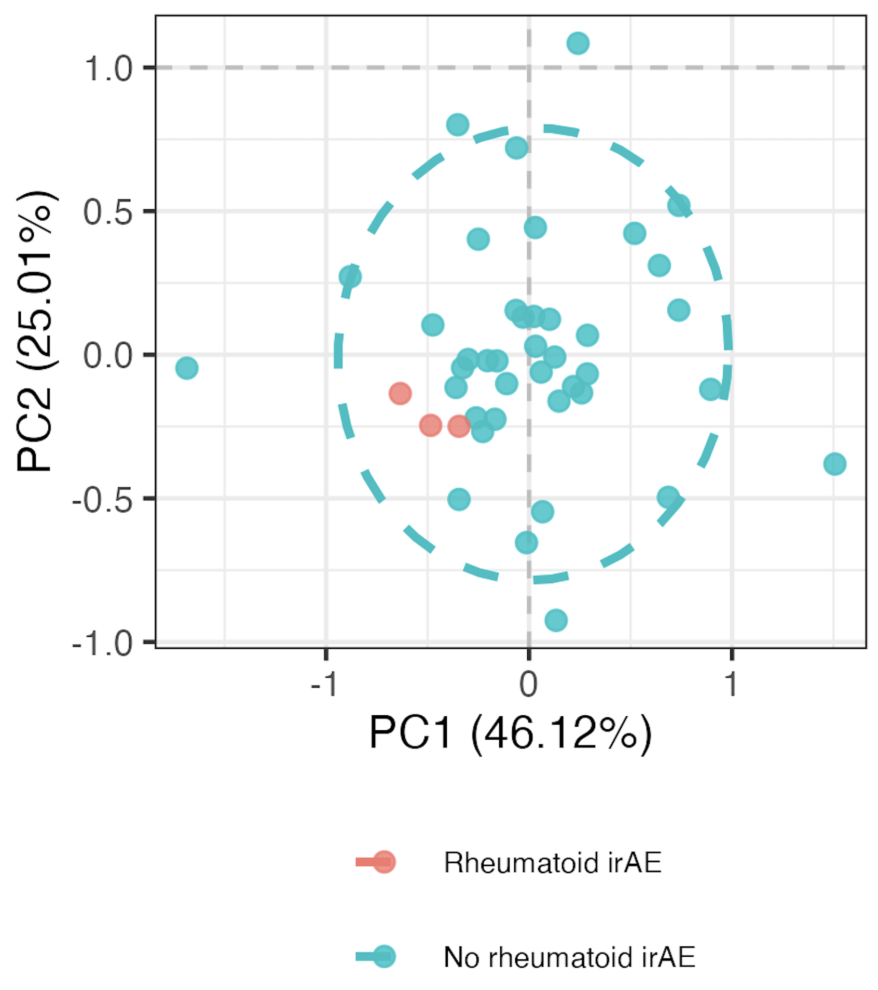
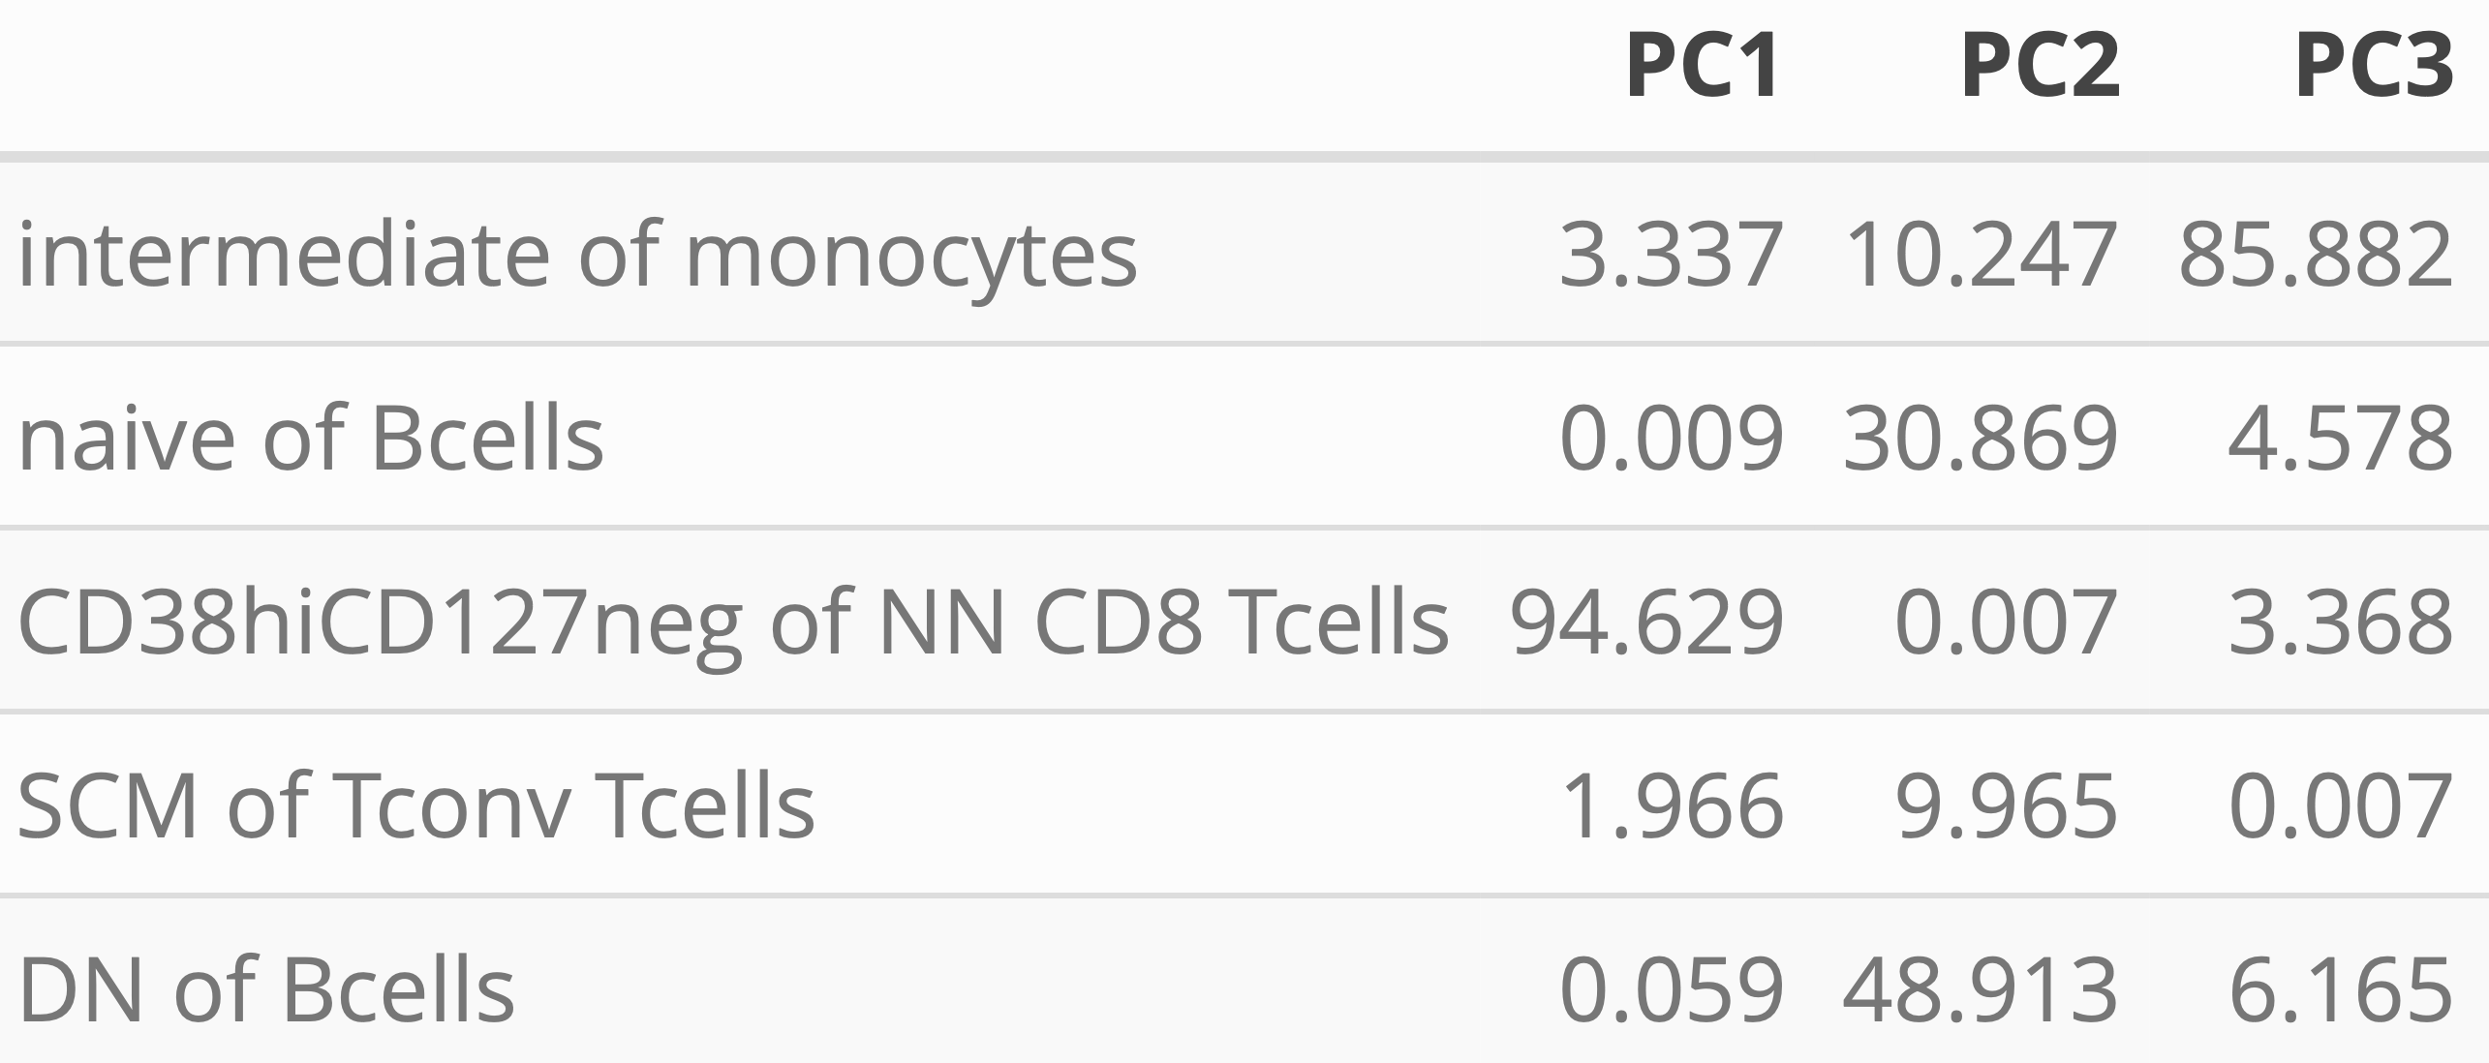
Using module of 5 baseline feature frequencies, can distinguish those who develop “rheumatoid” irAEs
PC1-3 contributions
PC1 **
PC2 ** PC3 *
Notes:
Opposite their result, but it was baseline

Slide 10
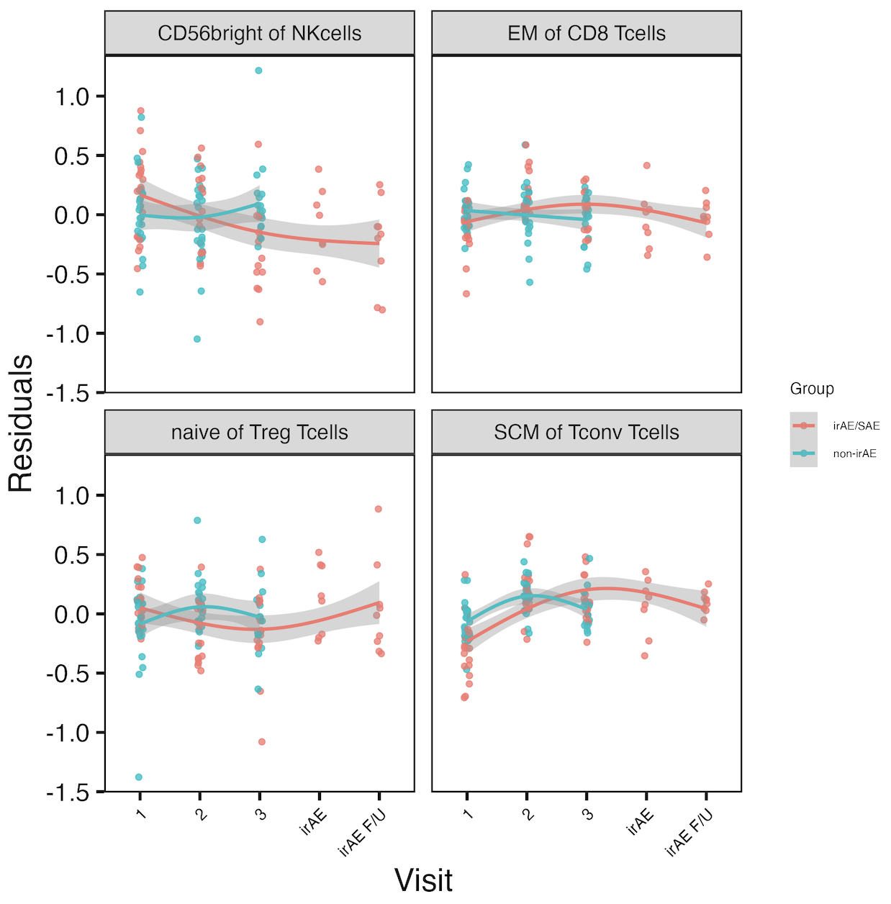
Longitudinal analyses: several features’ frequencies change in irAE group-specific manner over visits
Removed PD1⁺ sorts (15)
Used mixed effect non-linear model w/ interaction b/w irAE group & visit, random effect for donor
*
*
*
*
*
*: padj < 0.05
Notes:
See same trend in skin irAE group for CD56bright of NK, and this matches finding from Kovacsovics-Bankowski et al. J Immunother Cancer. 2024 (lower CD56bright of NK in patients at irAE max), surprisingly despite their cohort was mostly not pulmonary irAE and was mostly melanoma!

Slide 11
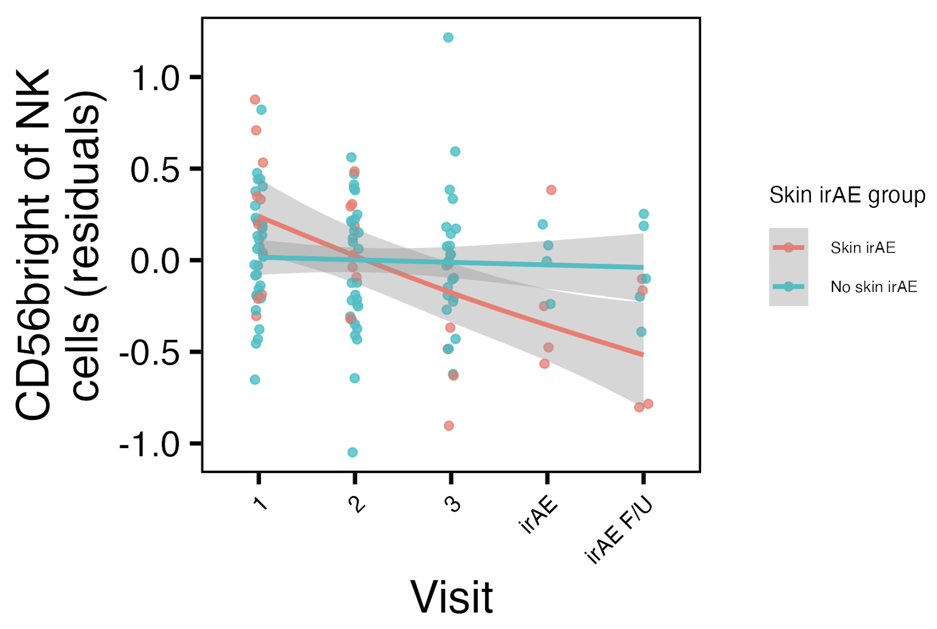
CD56^{bright} of NK frequency decreases with ICI in skin irAE group
*
*: padj < 0.05
Notes:
Same trend as in combined irAE group, and this matches finding from Kovacsovics-Bankowski et al. J Immunother Cancer. 2024 (lower CD56bright of NK in patients at irAE max), surprisingly despite their cohort was mostly not pulmonary irAE and was mostly melanoma!

Slide 12
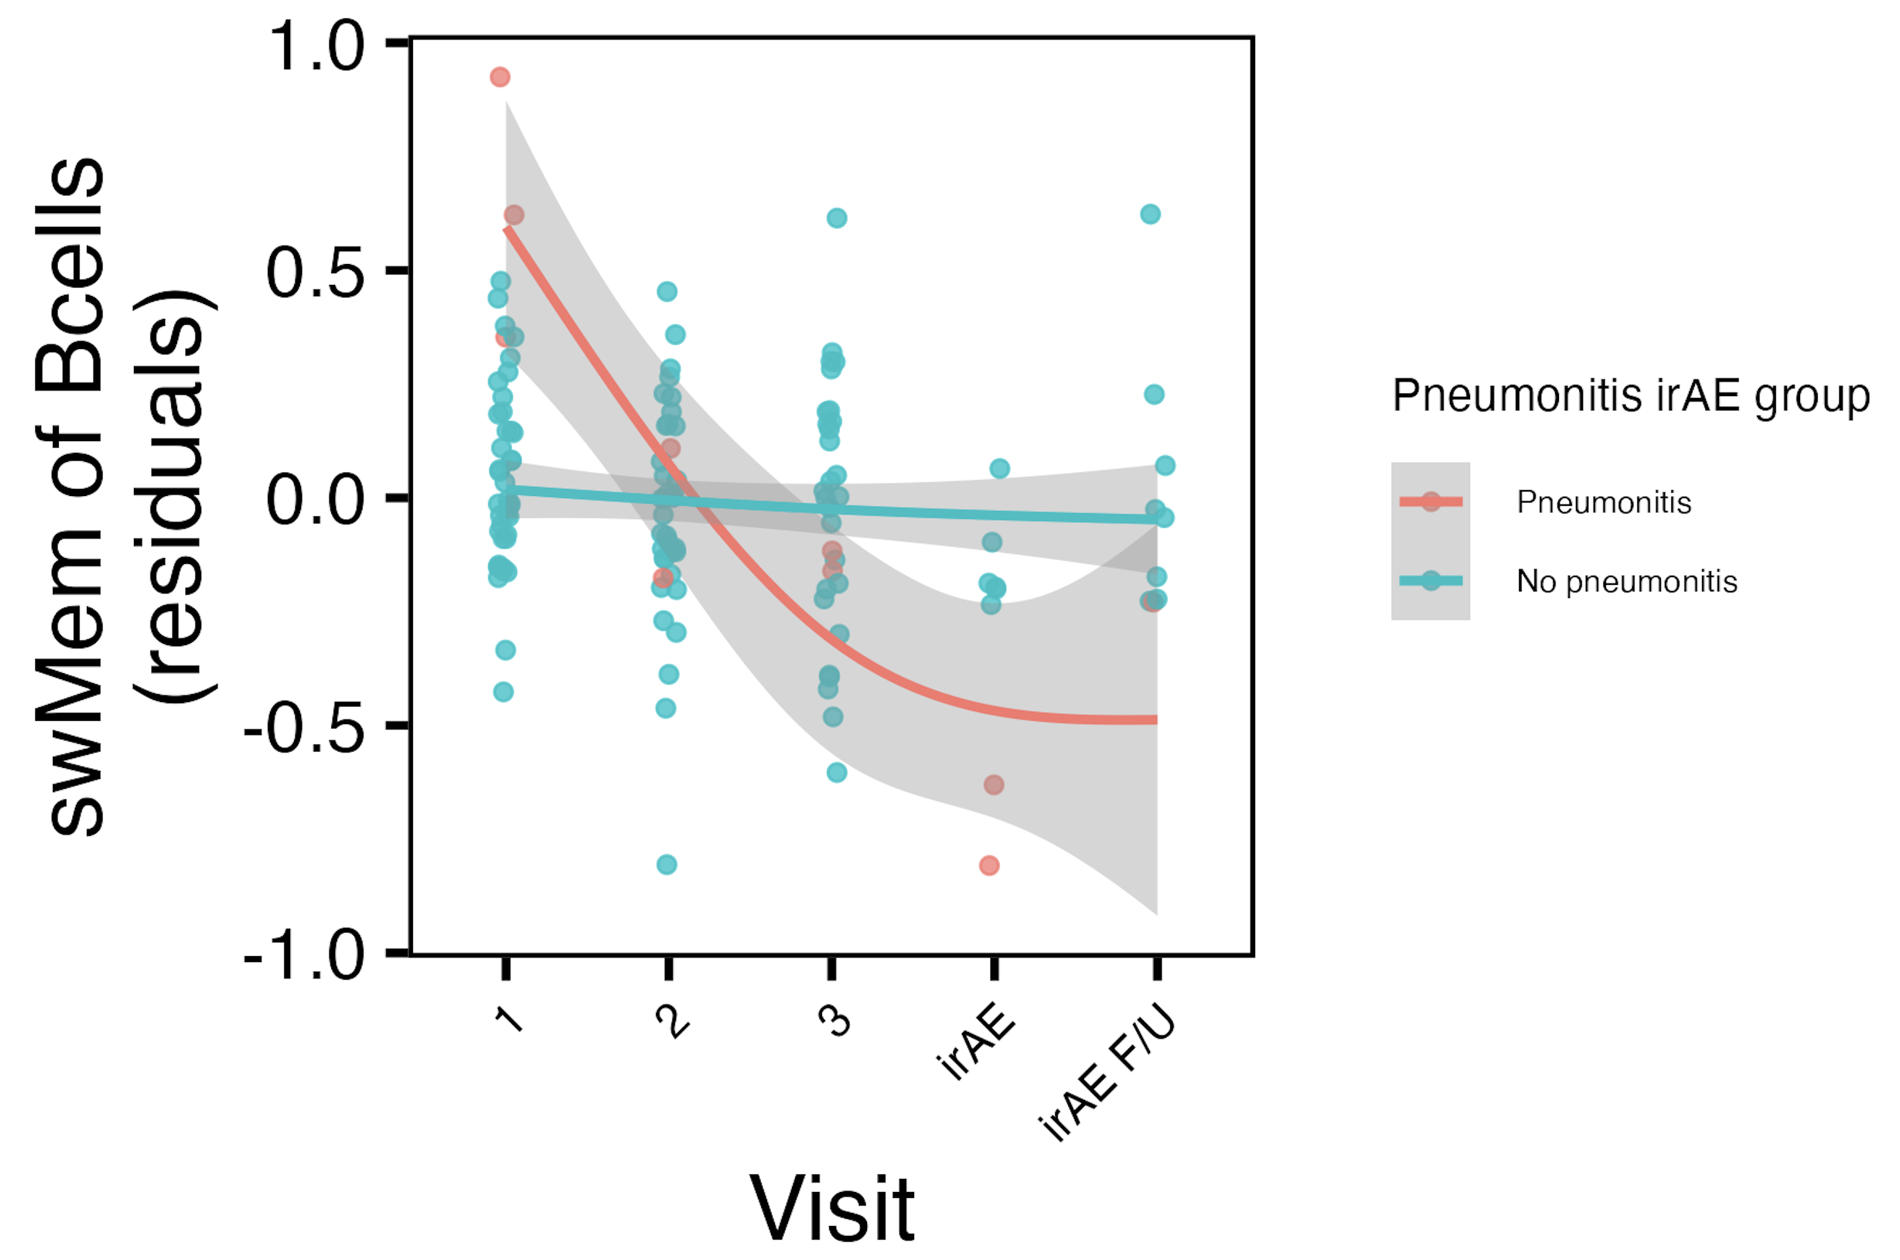
swMem of Bcells frequency decreases with ICI in pneumonitis irAE group
*
*: padj < 0.05

Slide 13
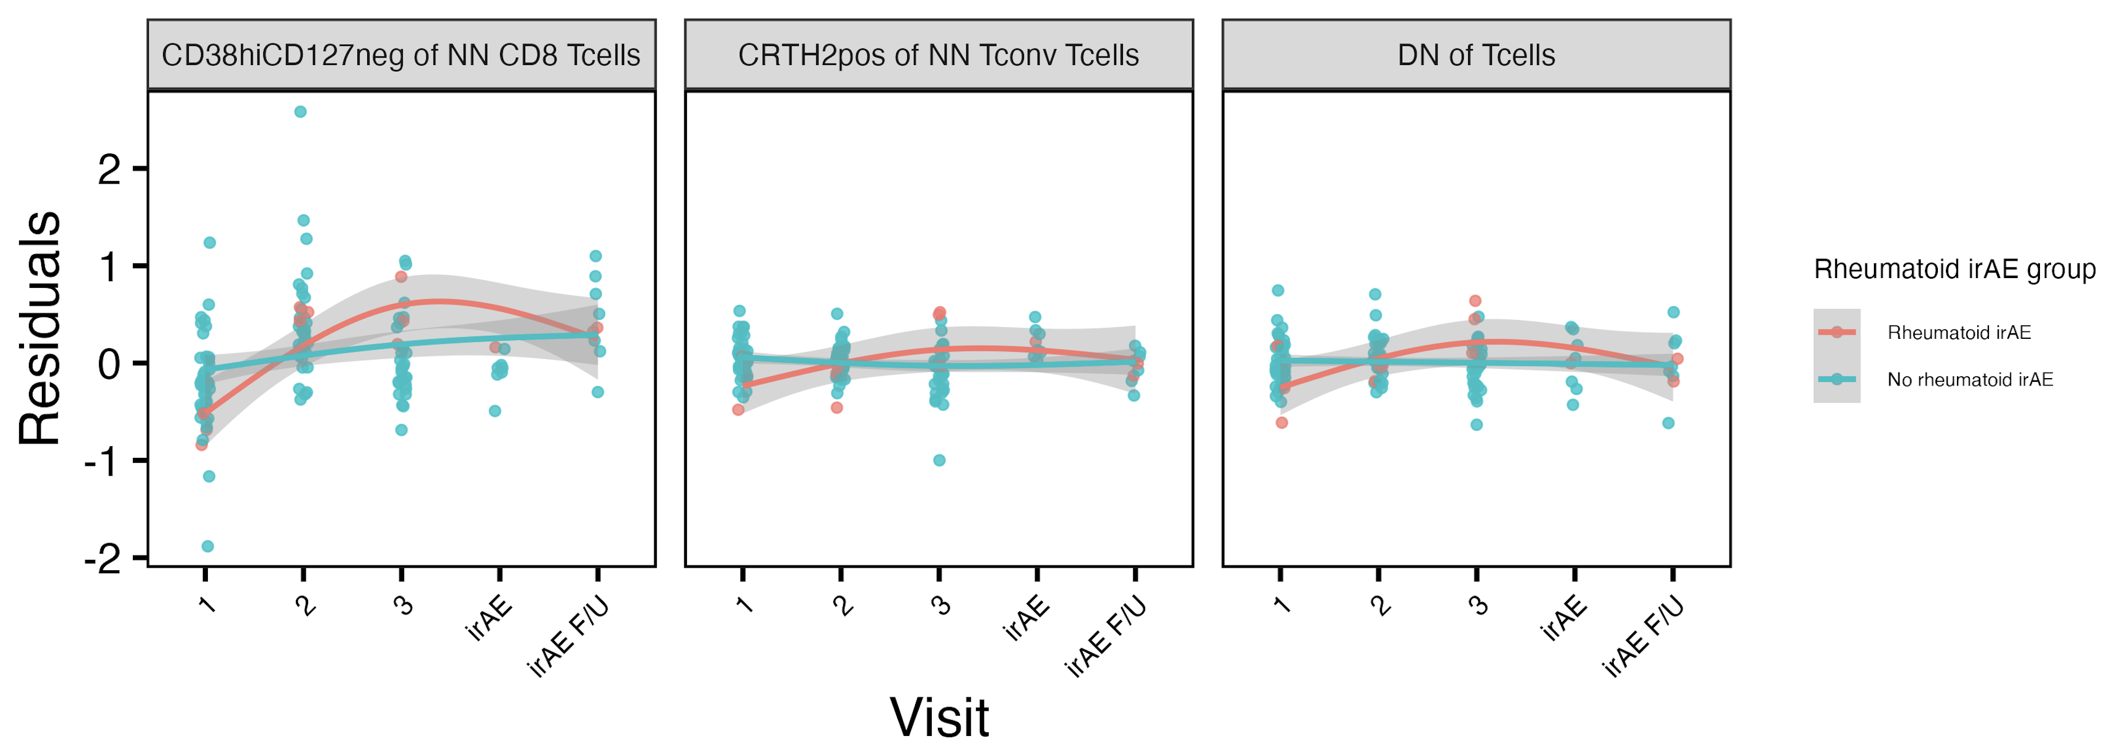
Several features’ frequencies change in “rheumatoid” irAE group-specific manner over visits
*
*
reported enriched in ICI-arthritis joints (Wang et al. Sci Immunol., 2023)
*: padj < 0.05
Notes:
# for rheumatoid, interaction (group-visit3) effects for DN of Tcells (padj = 0.044) and CRTH2+ of NN Tconv Tcells (padj = 0.015)

Slide 14
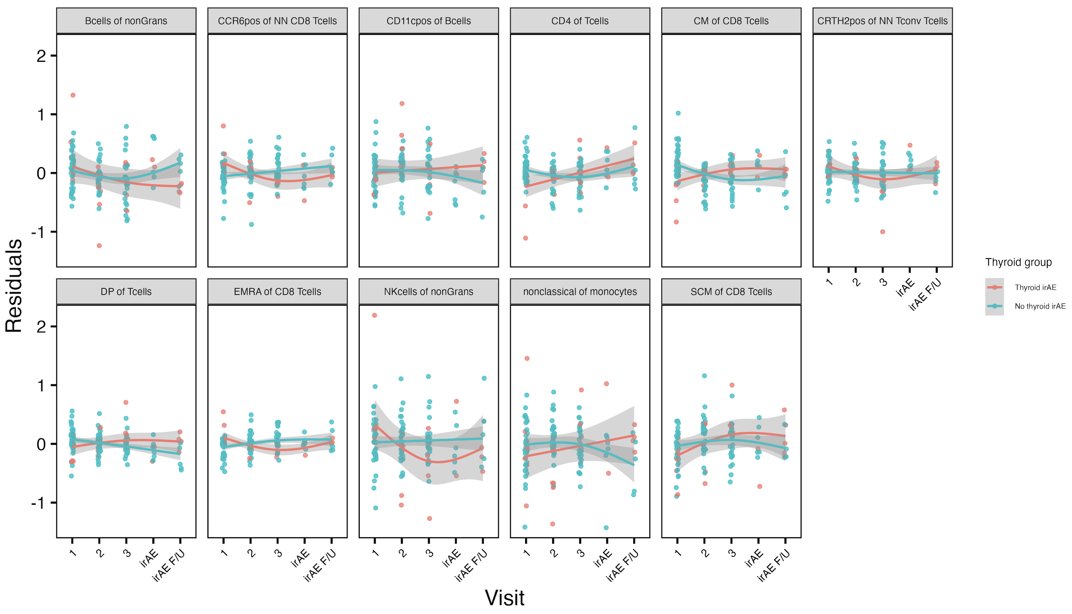
Several features’ frequencies change in thyroid irAE group-specific manner over visits
*
*
*
*
*
*
*
*
*
*
*
*
*
*
*
*: padj < 0.05

Slide 15
Conclusions
Baseline analyses
some features appear more irAE-type specific
can use module of features to identify immunotypes of combined irAE, thyroid irAEs, skin, “rheumatoid” irAEs
CD56^{bright} of NK cells frequency higher, PD1⁺ of NK cells frequency lower in those developing pneumonitis
Longitudinal analyses: some feature frequencies change with ICI in irAE group-specific manner
CD56^{bright} of NK frequency decreases with ICI in skin/combined irAE groups

Slide 16
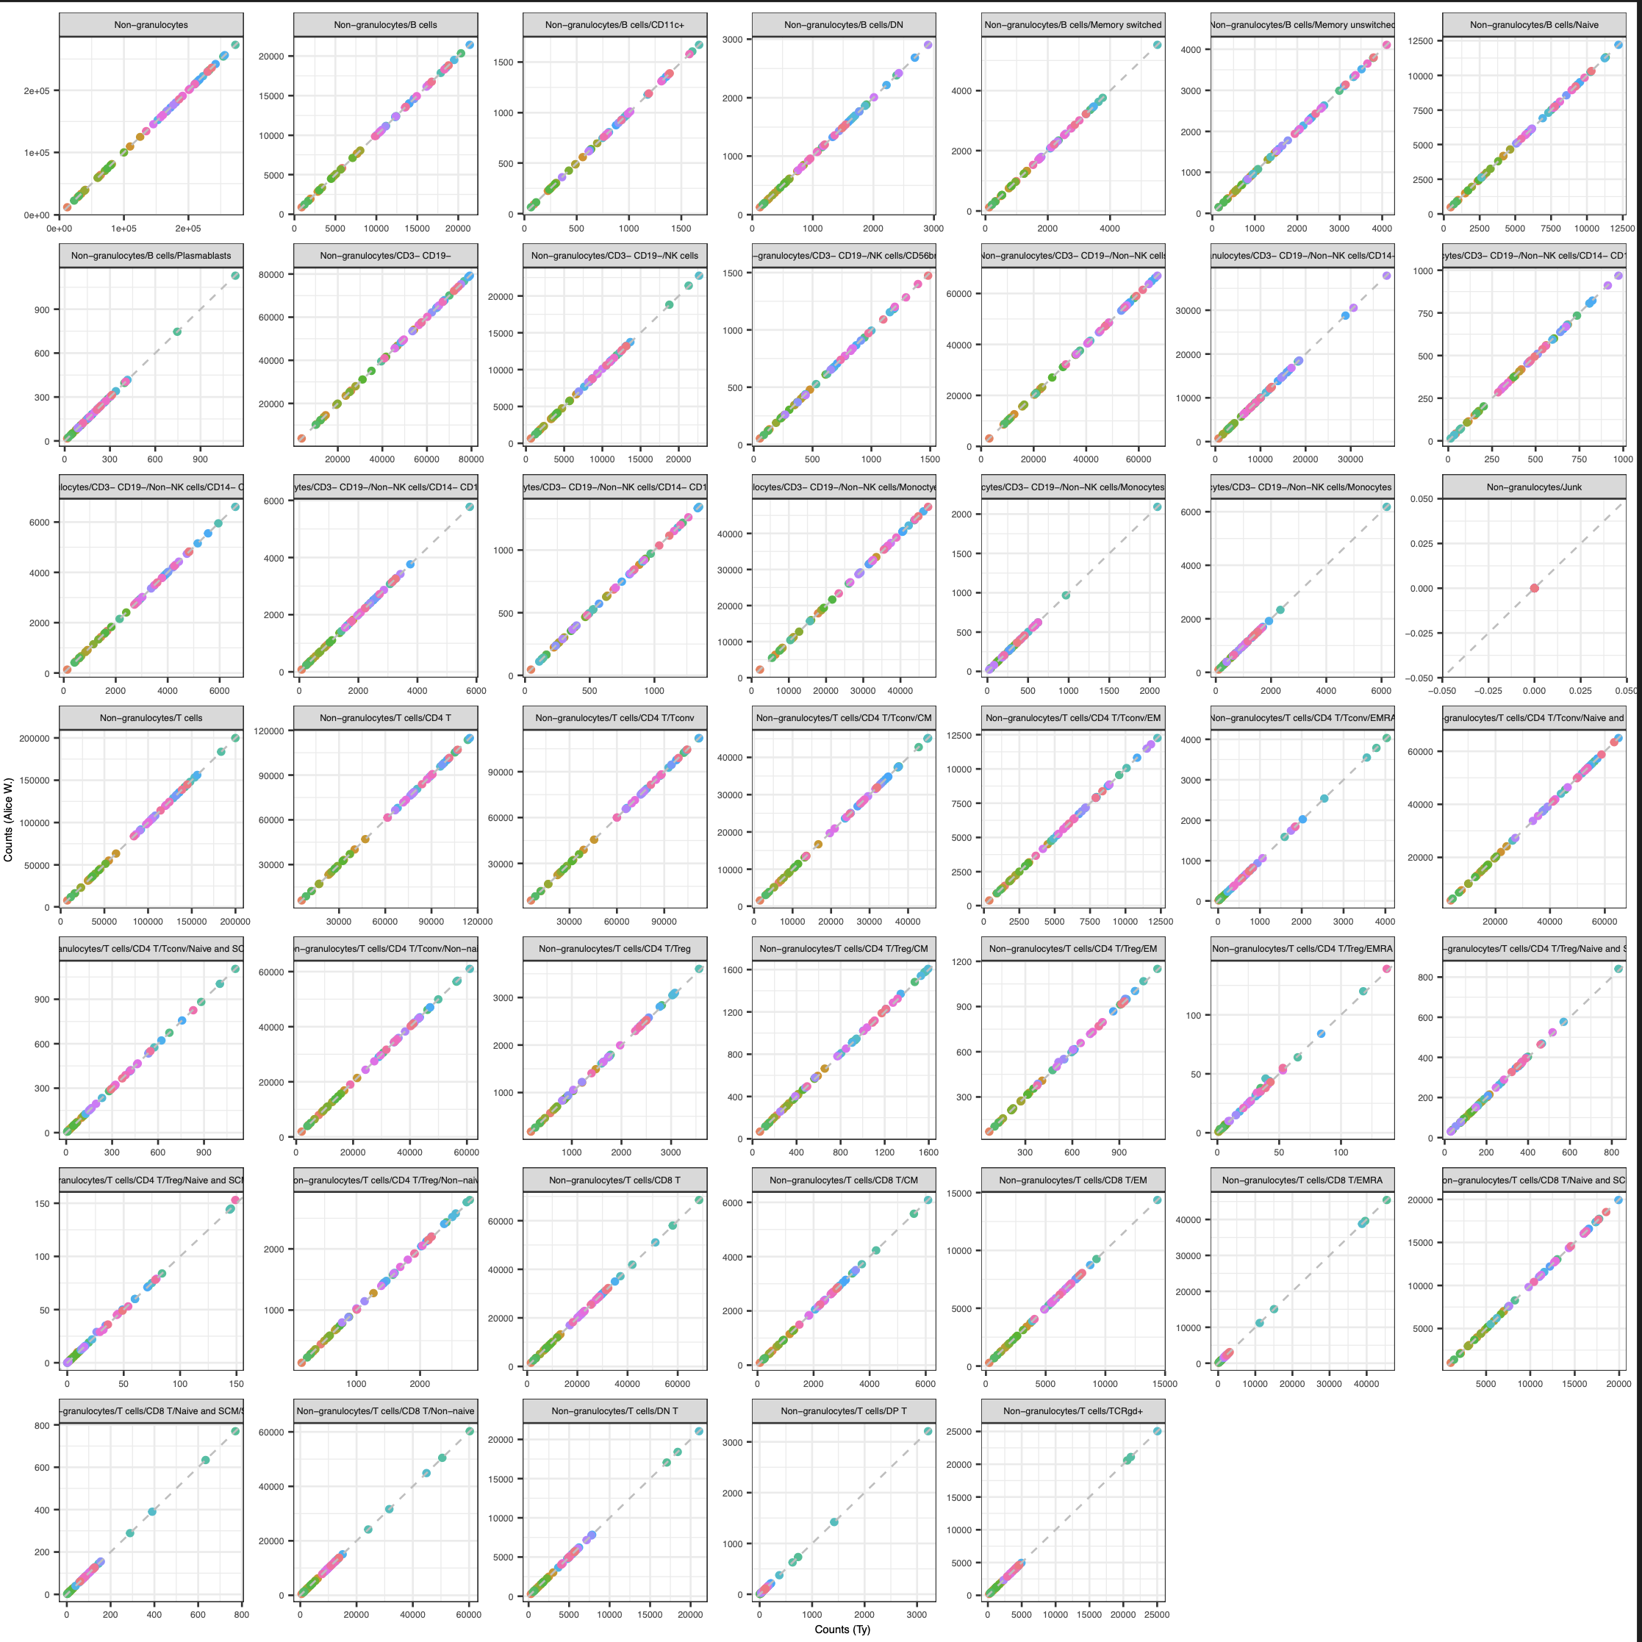
Next steps
IMPACD
created gating set in R, counts are ~expected values
will next look at gating at multiple, hierarchical levels
Test baseline results in public datasets
Notes:
Public data test is likely ~complicated by needing similar cohorts to see same effects

Slide 17

Acknowledgements
Holly Akilesh
Long lab/HIPcore
Alice Long, Alice Wiedeman
Buckner lab
Jane Buckner, Sylvia Posso
Peter Linsley
Hannah DeBerg
Clinical team

